Slide 1
STAT3007: Introduction to Stochastic Processes
Markov Chains - Some Special Examples
Dr. John Wright

Slide 2
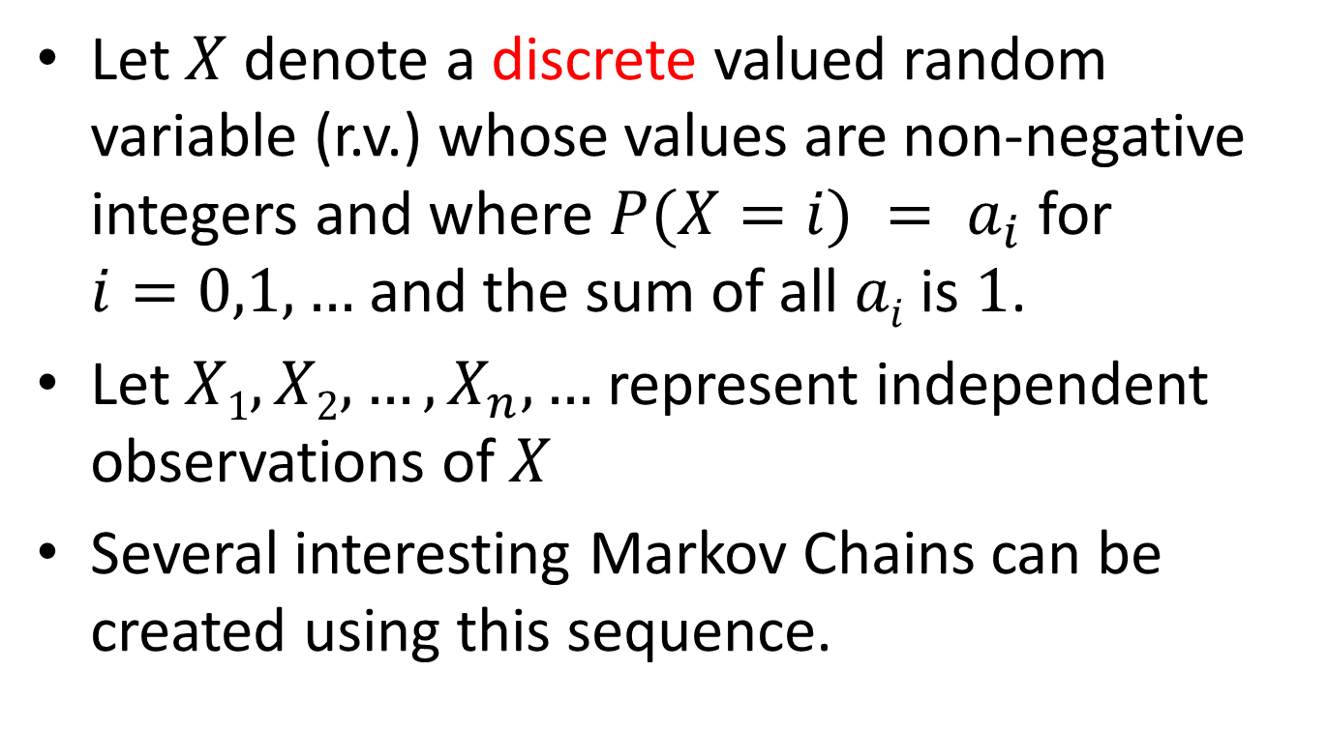
Markov Chains with I.I.D. R.V.s
Let $X$ denote a discrete valued random variable (r.v.) whose values are non-negative integers and where $P(X=i) = a_{i}$ for $i=0,1,…$and the sum of all $ai$ is $1$.
Let $X1, X2, …, X_{n}, …$represent independent observations of $X$
Several interesting Markov Chains can be created using this sequence.

Slide 3
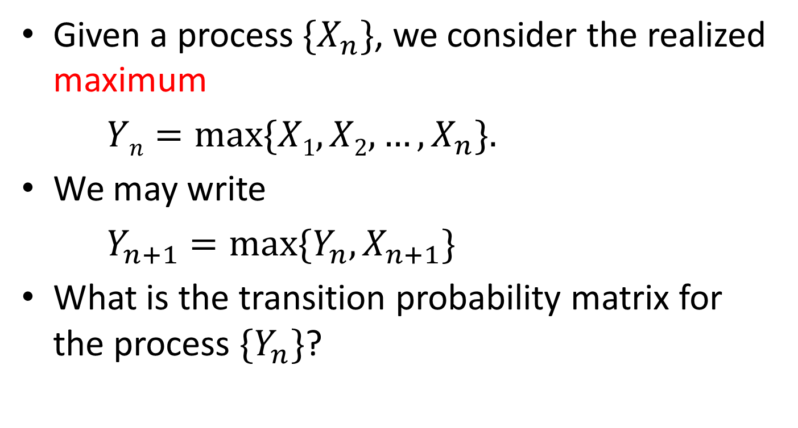
Successive Maxima
Given a process $\{X_{n}\}$, we consider the realized maximum
$Yn=max⁡\{X1, X2, …, X_{n}\}.$
We may write
$Y_{n+1}=max⁡\{Y_{n}, X_{n+1}\}$
What is the transition probability matrix for the process $\{Y_{n}\}$?

Slide 4

Successive Maxima
$P=\left(\begin{matrix}A_{0} & a_{1} & a_{2} & a_{3} & ⋯ \\ 0 & A_{1} & a_{2} & a_{3} & ⋯ \\ 0 & 0 & A_{2} & a_{3} & ⋯ \\ 0 & 0 & 0 & A_{3} & ⋯ \\ ⋮ & ⋮ & ⋮ & ⋮ & ⋱\end{matrix}\right)$
Where $A_{k}=a_{0}+a_{1}+⋯+a_{k}$

Slide 5
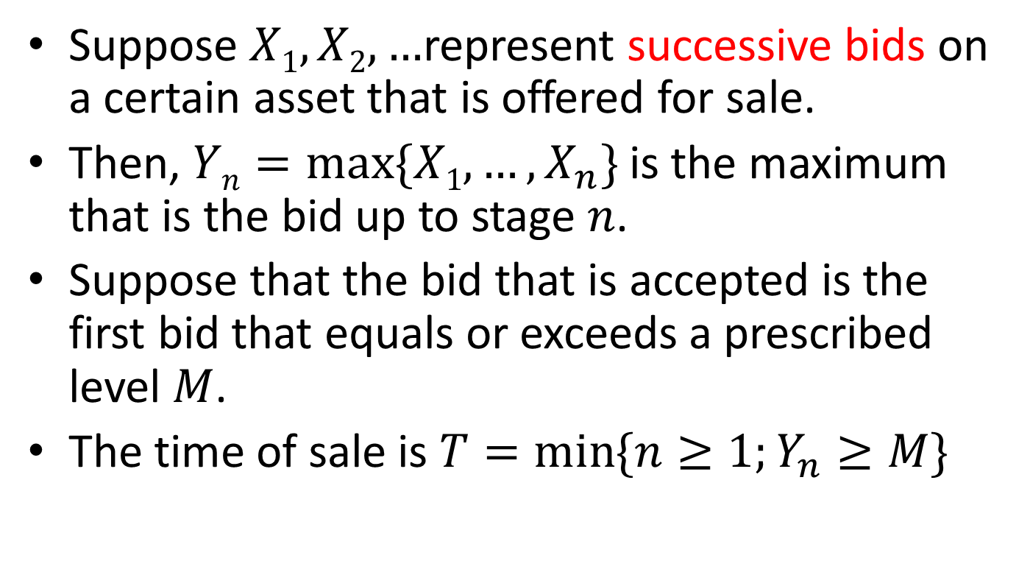
Bids and Sales
Suppose $X1,X2, …$represent successive bids on a certain asset that is offered for sale.
Then, $Yn=max⁡\{X1, …, X_{n}\}$is the maximum that is the bid up to stage $n$.
Suppose that the bid that is accepted is the first bid that equals or exceeds a prescribed level $M$.
The time of sale is $T=\min{\{n≥1;Y_{n}≥M\}}$

Slide 6
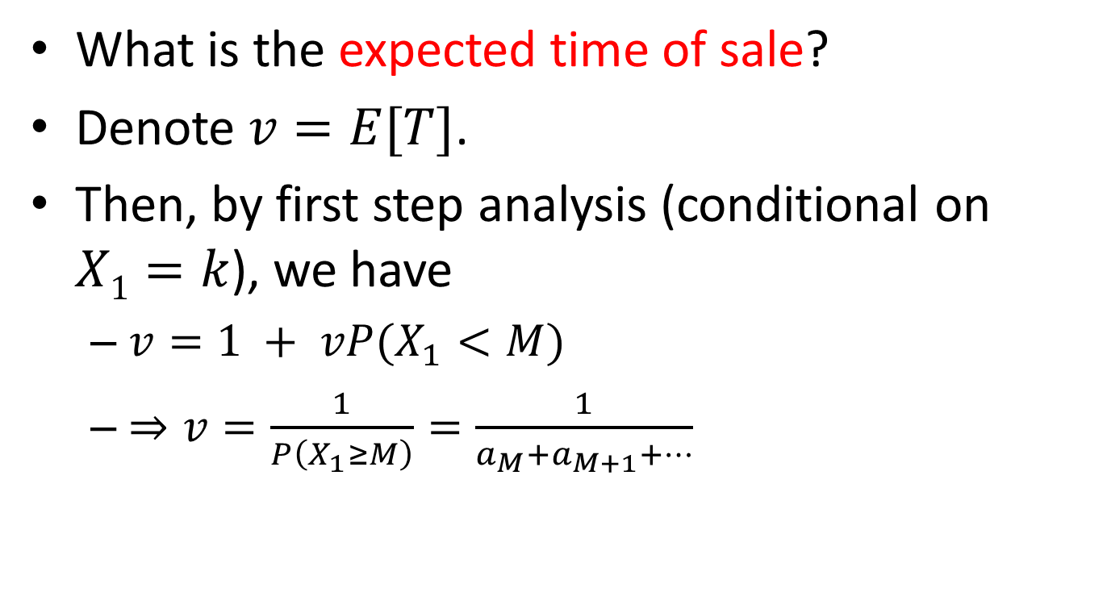
Bids and Sales
What is the expected time of sale?
Denote $v=E[T]$.
Then, by first step analysis (conditional on $X1=k$), we have
$v=1 + vP(X_{1}<M)$
$⇒v=\frac{1}{P\left(X_{1}≥M\right)}=\frac{1}{a_{M}+a_{M+1}+⋯}$

Slide 7

Partial Sums
Given the same process of i.i.d. r.v.s $\{X_{n}\}$, define $Z_{n}=X_{1}+⋯+X_{n}$
What is the transition probability matrix for the process $\left\{Z_{n}\right\}$?

Slide 8




One-Dimensional Random Walk
$$ri$$
$$pi$$
$$P=\begin{matrix}0 \\ 1 \\ 2 \\ ⋮ \\ i \\ \end{matrix}\left(\begin{matrix}r_{0} & p_{0} & 0 & ⋯ & 0 & ⋯ & ⋯ & \\ q_{1} & r_{1} & p_{1} & ⋯ & 0 & ⋯ & ⋯ & \\ 0 & q_{2} & r_{2} & ⋯ & 0 & ⋯ & ⋯ & \\ & ⋱ & & & & & & \\ & & 0 & ⋯ & q_{i} & r_{i} & p_{i} & ⋯ \\ & & & ⋱ & ⋱ & ⋱ & ⋱ & ⋱\end{matrix}\right)$$
$$qi$$

Slide 9
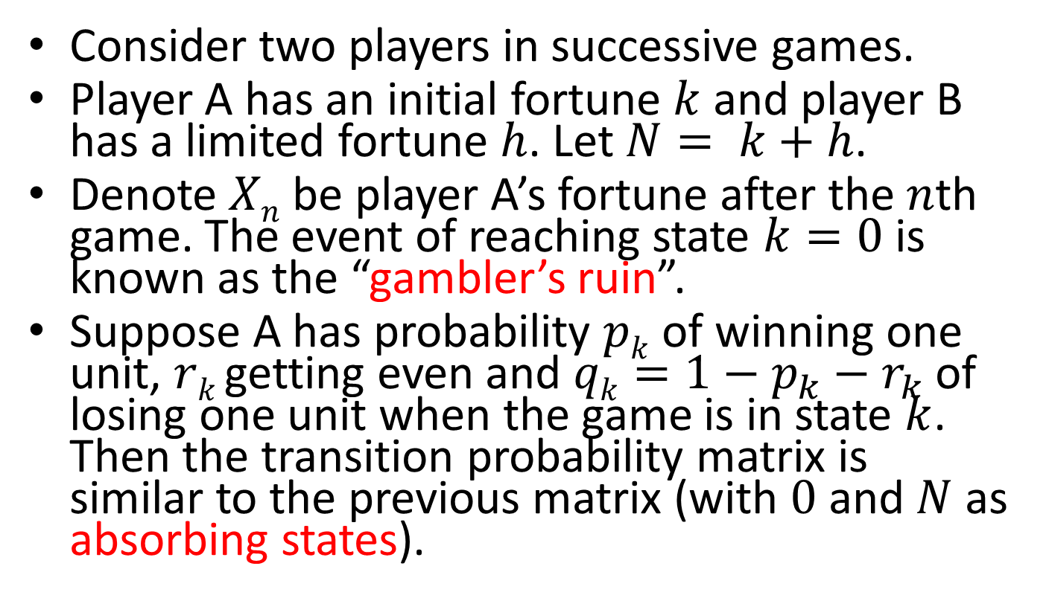
Gambler’s Ruin
Consider two players in successive games.
Player A has an initial fortune $k$ and player B has a limited fortune $h$. Let $N= k+h$.
Denote $Xn$ be player A’s fortune after the $n$th game. The event of reaching state $k=0$is known as the “gambler’s ruin”.
Suppose A has probability $pk$ of winning one unit, $rk$ getting even and $qk=1−p_{k}−r_{k}$of losing one unit when the game is in state $k$. Then the transition probability matrix is similar to the previous matrix (with $0$ and $N$ as absorbing states).

Slide 10
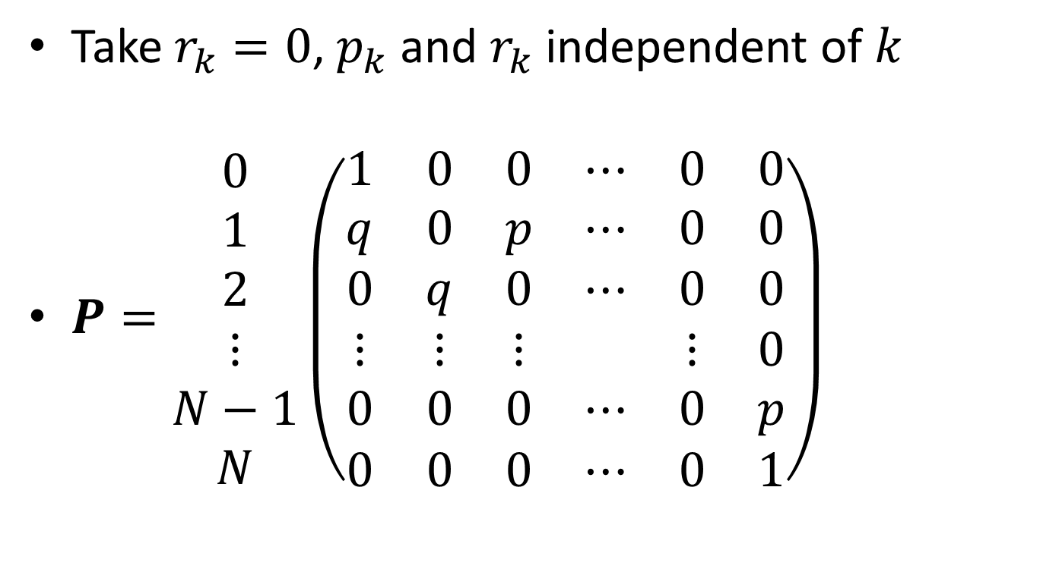
Gambler’s Ruin
Take $r_{k}=0$, $p_{k}$ and $r_{k}$ independent of $k$
$P=\begin{matrix}0 \\ 1 \\ 2 \\ ⋮ \\ N−1 \\ N\end{matrix}\left(\begin{matrix}1 & 0 & 0 & ⋯ & 0 & 0 \\ q & 0 & p & ⋯ & 0 & 0 \\ 0 & q & 0 & ⋯ & 0 & 0 \\ ⋮ & ⋮ & ⋮ & & ⋮ & 0 \\ 0 & 0 & 0 & ⋯ & 0 & p \\ 0 & 0 & 0 & ⋯ & 0 & 1\end{matrix}\right)$

Slide 11
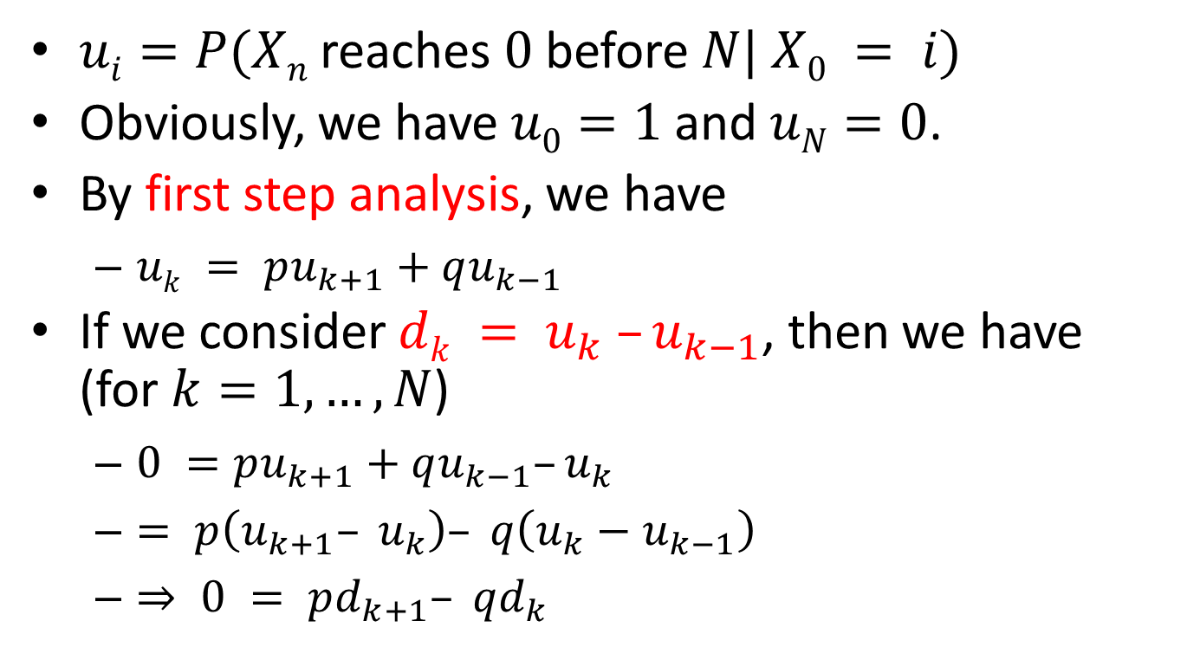
Gambler’s Ruin
$ui=P(Xn$reaches$0$before$N| X0 = i)$
Obviously, we have $u0=1$and $uN=0$.
By first step analysis, we have
$uk = pu_{k+1}+qu_{k−1}$
If we consider $dk = u_{k} –u_{k−1}$, then we have (for $k=1,…,N$)
$0 =pu_{k+1}+qu_{k−1}–u_{k}$
$= p\left(u_{k+1}– u_{k}\right)– q\left(u_{k}−u_{k−1}\right)$
$⇒ 0 = pd_{k+1}– qd_{k}$

Slide 12
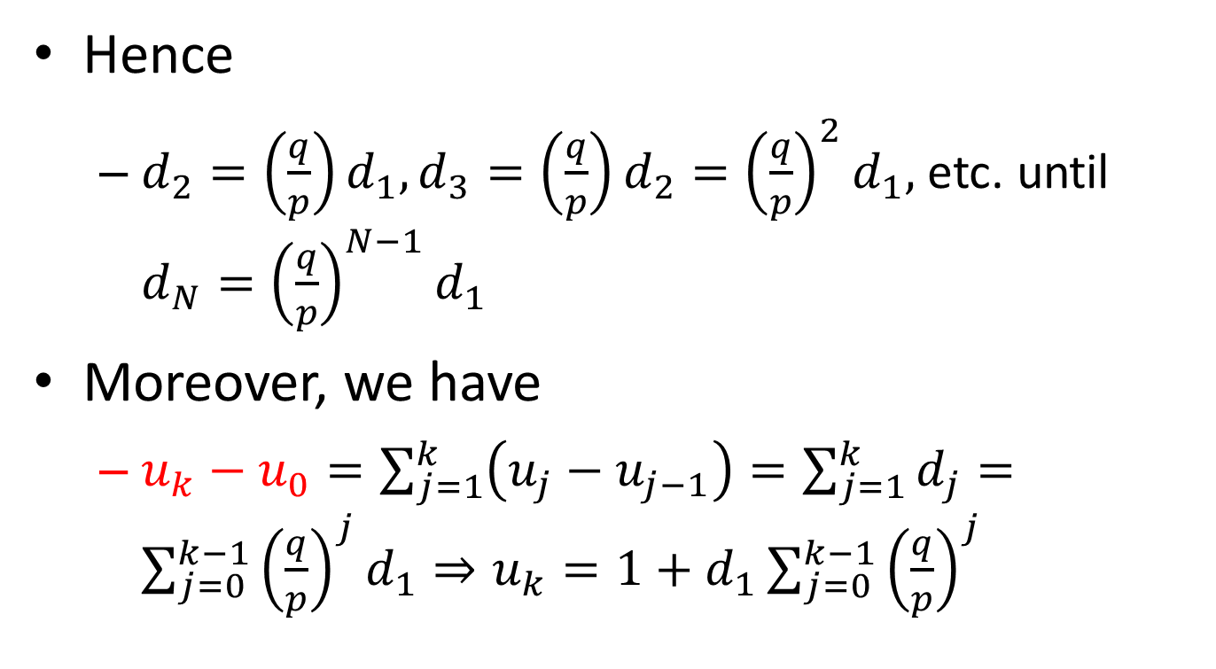
Gambler’s Ruin
Hence
$d_{2}=\left(\frac{q}{p}\right)d_{1}, d_{3}=\left(\frac{q}{p}\right)d_{2}={\left(\frac{q}{p}\right)}^{2}d_{1},$ etc. until $d_{N}={\left(\frac{q}{p}\right)}^{N−1}d_{1}$
Moreover, we have
$u_{k}−u_{0}=\sum_{j=1}^{k}{\left(u_{j}−u_{j−1}\right)}=\sum_{j=1}^{k}{d_{j}}=\sum_{j=0}^{k−1}{{\left(\frac{q}{p}\right)}^{j}d_{1}}⇒u_{k}=1+d_{1}\sum_{j=0}^{k−1}{{\left(\frac{q}{p}\right)}^{j}}$

Slide 13
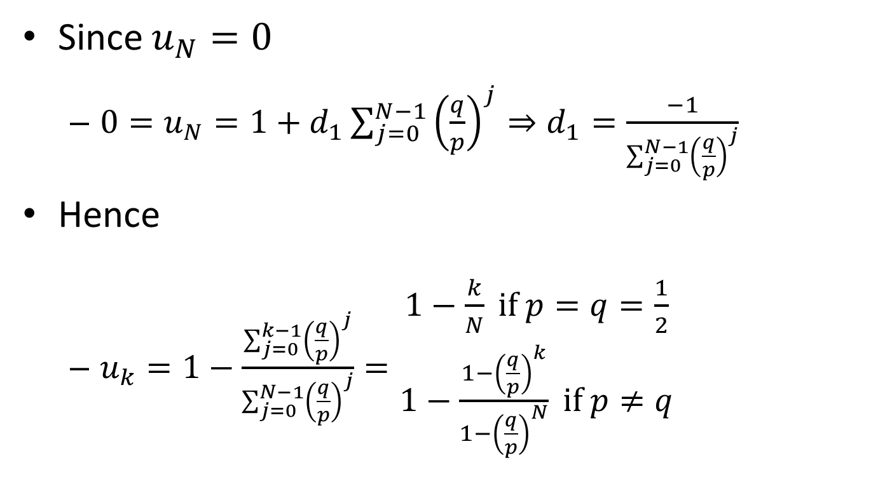
Gambler’s Ruin
Since $u_{N}=0$
$0=u_{N}=1+d_{1}\sum_{j=0}^{N−1}{{\left(\frac{q}{p}\right)}^{j}}⇒d_{1}=\frac{−1}{\sum_{j=0}^{N−1}{{\left(\frac{q}{p}\right)}^{j}}}$
Hence
$u_{k}=1−\frac{\sum_{j=0}^{k−1}{{\left(\frac{q}{p}\right)}^{j}}}{\sum_{j=0}^{N−1}{{\left(\frac{q}{p}\right)}^{j}}}=\begin{matrix}1−\frac{k}{N} if p=q=\frac{1}{2} \\ 1−\frac{1−{\left(\frac{q}{p}\right)}^{k}}{1−{\left(\frac{q}{p}\right)}^{N}} if p≠q\end{matrix}$

Slide 14
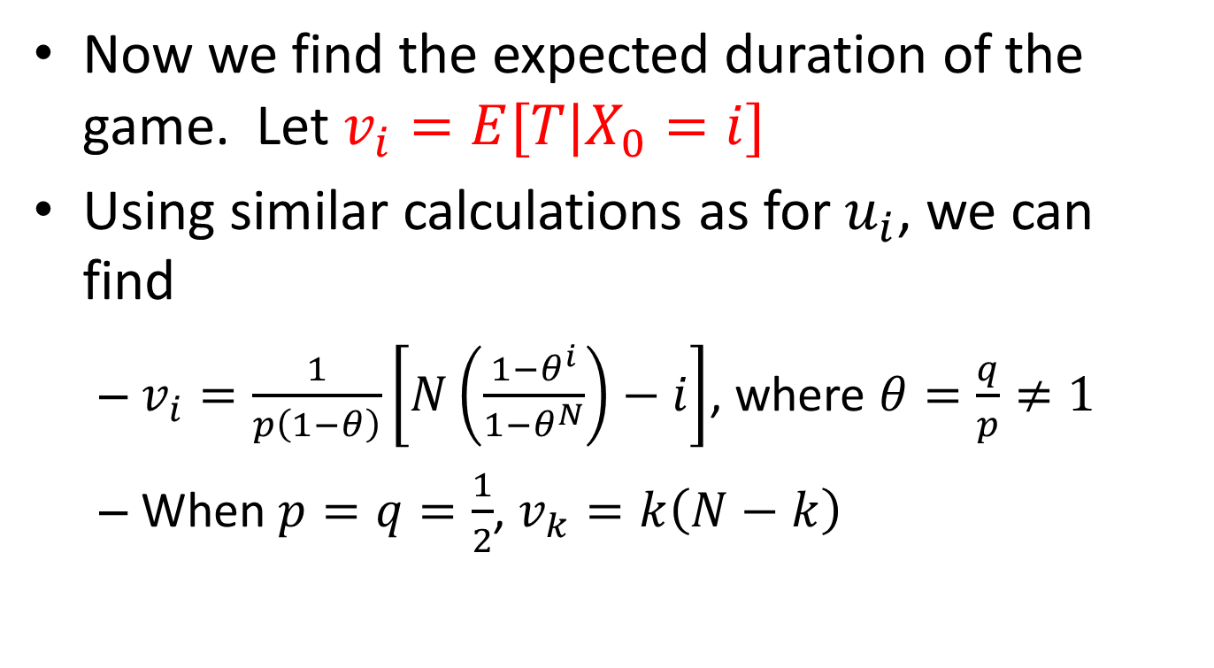
Gambler’s Ruin
Now we find the expected duration of the game. Let $v_{i}=E[T|X_{0}=i]$
Using similar calculations as for $u_{i}$, we can find
$v_{i}=\frac{1}{p\left(1−θ\right)}\left[N\left(\frac{1−θ^{i}}{1−θ^{N}}\right)−i\right]$, where $θ=\frac{q}{p}≠1$
When $p=q=\frac{1}{2}$, $v_{k}=k\left(N−k\right)$

Slide 15
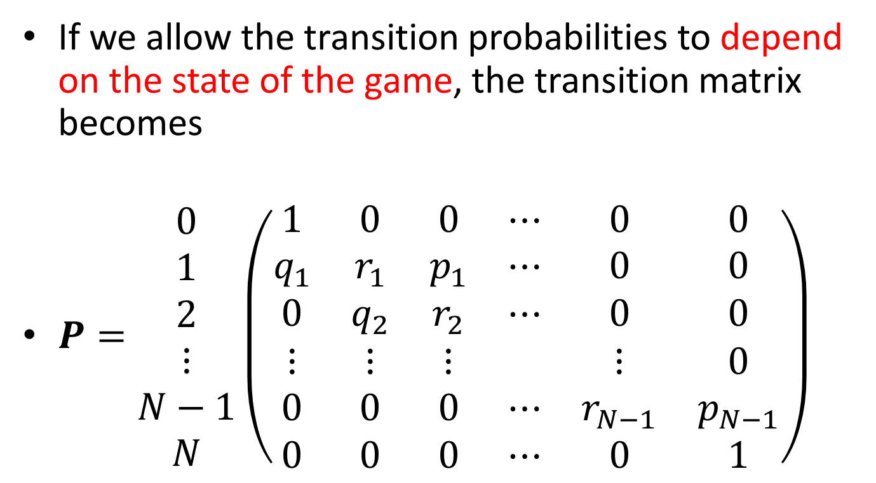
Gambler’s Ruin
If we allow the transition probabilities to depend on the state of the game, the transition matrix becomes
$P=\begin{matrix}0 \\ 1 \\ 2 \\ ⋮ \\ N−1 \\ N\end{matrix}\left(\begin{matrix}1 & 0 & 0 & ⋯ & 0 & 0 \\ q_{1} & r_{1} & p_{1} & ⋯ & 0 & 0 \\ 0 & q_{2} & r_{2} & ⋯ & 0 & 0 \\ ⋮ & ⋮ & ⋮ & & ⋮ & 0 \\ 0 & 0 & 0 & ⋯ & r_{N−1} & p_{N−1} \\ 0 & 0 & 0 & ⋯ & 0 & 1\end{matrix}\right)$

Slide 16
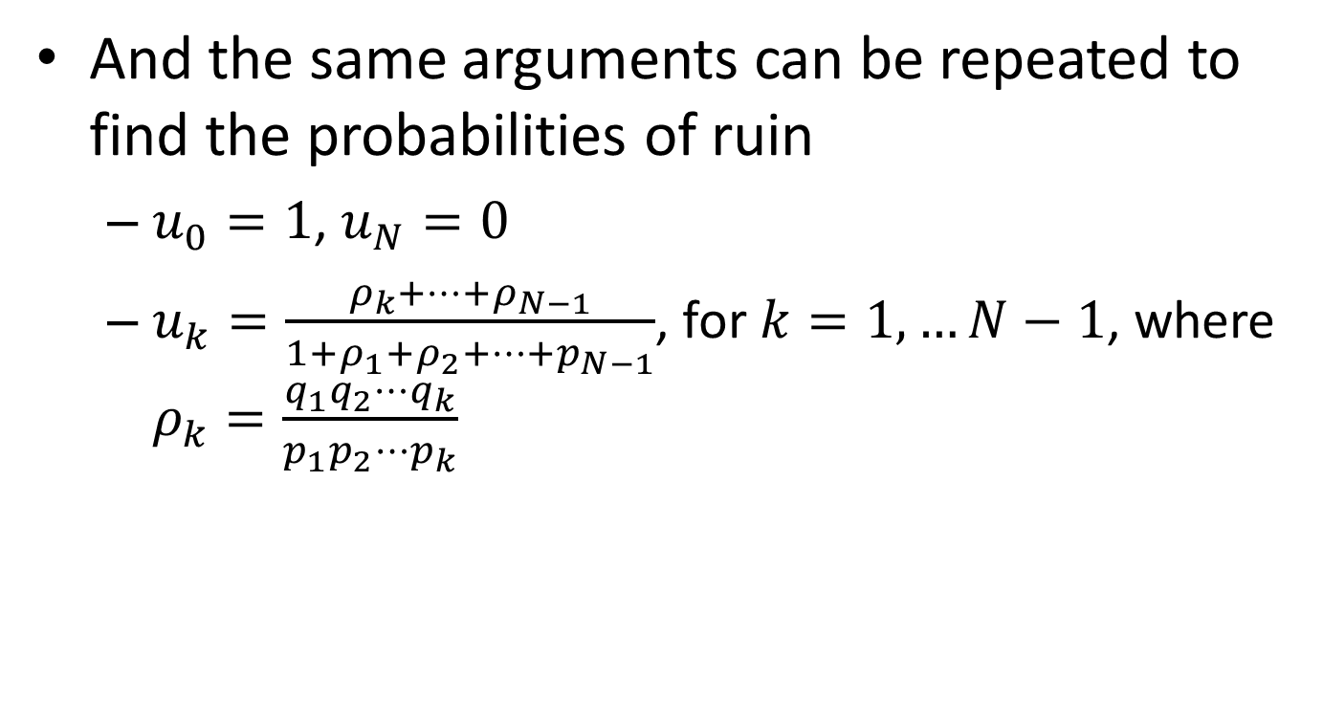
Gambler’s Ruin
And the same arguments can be repeated to find the probabilities of ruin
$u_{0}=1$, $u_{N}=0$
$u_{k}=\frac{ρ_{k}+⋯+ρ_{N−1}}{1+ρ_{1}+ρ_{2}+⋯+p_{N−1}}$, for $k=1,…N−1$, where $ρ_{k}=\frac{q_{1}q_{2}⋯q_{k}}{p_{1}p_{2}⋯p_{k}}$

Slide 17
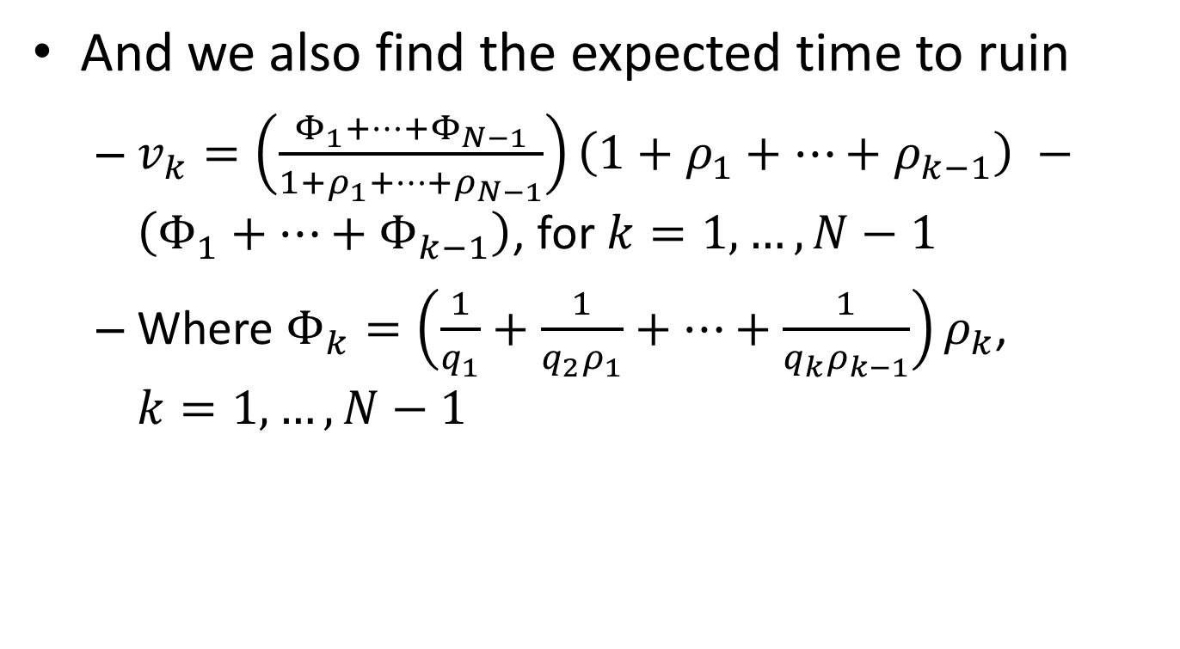
Gambler’s Ruin
And we also find the expected time to ruin
$v_{k}=\left(\frac{Φ_{1}+⋯+Φ_{N−1}}{1+ρ_{1}+⋯+ρ_{N−1}}\right)\left(1+ρ_{1}+⋯+ρ_{k−1}\right) −\left(Φ_{1}+⋯+Φ_{k−1}\right)$, for $k=1,…,N−1$
Where $Φ_{k}=\left(\frac{1}{q_{1}}+\frac{1}{q_{2}ρ_{1}}+⋯+\frac{1}{q_{k}ρ_{k−1}}\right)ρ_{k}$, $k=1,…,N−1$

